Slide 1
Password Complexity on Attacker Engagement
By Team 2J - Byte Sized
Joshua Huang
Nathan Li
Yemi Ogunsola
Kaleb Ward

Slide 2
Overview
Background
Research & Hypothesis
Honeypot Architecture
Data Collection
Data Analysis
Key Takeaways

Slide 3
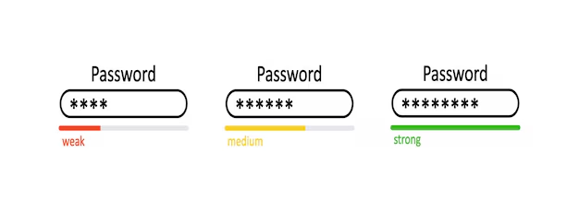
What Makes a Password Good?
Background
Research
Hypothesis
Architecture
Data Collect
Data Analysis
Conclusion
PASSWORD COMPLEXITY is the “usage of allowed characters, length, and symmetry of a password”
PASSWORD STRENGTH is the number of attacks necessary for an attacker to crack a password
(Sahin, Lychev, & Wagner, 2015).
Notes:
Very concisely clarify/define key terms
Weak Password - Alpha Characters, no capitalization,
Medium Password - Non

Slide 4
Research Question
Background
Research
Hypothesis
Architecture
Data Collect
Data Analysis
Conclusion
❔
How does the password complexity of credential-secured directories
affect attacker behavior within a system?
x
y
Independent Variables:
Password Complexity: None, Low, Med, High
Dependent Variable:
Types of Commands: File Management, System Information, etc.
Password Cracking Techniques: Brute Force, Rainbow Tables, etc.
Number of Commands
Duration of Time in Environment: milli-seconds
Notes:
Explain the research question the team is investigating
State the question as well as provide the class the required background information to understand what the question is investigating
Explain assumption of expecting attackers to interact with the directories
One limitation is that we can’t control the types of attacks -> possibly making it difficult to draw clear conclusions
^Back up research question: Examines overall attacker behavior (e.g., what actions they take beyond password cracking)

Slide 5





Hypothesis
Background
Research
Hypothesis
Architecture
Data Collect
Data Analysis
Conclusion
Types of Commands
Password Cracking Techniques
Number of Commands
Duration
Null Hypothesis
The password complexity of credential-secured directories does not affect attacker behavior
within the system.
Notes:
State the hypothesis and justify

Slide 6

Hypothesis
Background
Research
Hypothesis
Architecture
Data Collect
Data Analysis
Conclusion
Increase in File Management Commands
Increase in Password Cracking Techniques
Increase in Number of Commands
Increase in Duration of Attacker Sessions
Alternative Hypothesis
Increasing password complexity of credential-secured directories significantly affects attacker behavior within the system.
Notes:
State the hypothesis and justify

Slide 7



Honeypot Architecture
Background
Research
Hypothesis
Architecture
Data Collect
Data Analysis
Conclusion
↺
↺
Notes:
Describe the planned architecture of honeypot system
Concisely describe the honeypot recycle strategy
Explain any anticipated potential issues with any of the above design decision
Mention 30 minute recycling time
Mention how directories will be secured using eCrypts Linux tool

Slide 8
Changes Made Over Time
Background
Research
Hypothesis
Architecture
Data Collect
Data Analysis
Conclusion
Addition of 5th Container
Reduction in Snapshot Usage
MITM Log Parsing Script Development
Enhanced Recycling Script
Transition from encryptfs to Zip Tool
Iptables Rules for Blocking Repeat Attackers
Notes:
Describe the planned architecture of honeypot system
Concisely describe the honeypot recycle strategy
Explain any anticipated potential issues with any of the above design decision
Mention 30 minute recycling time
Mention how directories will be secured using eCrypts Linux tool

Slide 9



Data Collection
Background
Research
Hypothesis
Architecture
Data Collect
Data Analysis
Conclusion
Pre-Process Logs in Python
MITM Port, Attacker IP, Duration, Commands Used
Visual and Statistical Analysis
Man-in-the-Middle Server
Eliminating Outliers, Unique Attacks, Filtering Commands
Notes:
Describe the methods and tools that will be used to collect the data
Concisely and clearly define the type of data to be collected
Explain how the data that these tools provide will be able to answer the research question
Direct Data: Time - Parse the MITM logs for duration of time
Indirect Data: - Parse the serve for key words, methods (brute force)

Slide 10
Types & Frequency of Commands
Background
Research
Hypothesis
Architecture
Data Collect
Data Analysis
Conclusion
Command Type | Commands Used | Frequency
System Information | uname -s -v -n -r -m, uname -a, uname -s | 8012
File Permissions | cd ~; chattr -ia .ssh; lockr -ia .ssh | 7235
Install Packages | apt | 205
Read and Write File | cat && exit 100 || more && exit 101 || less && exit 102 || tee && exit 103 || tr x x && exit 104 || read v && echo -e "$v" && exit 105 || exit 113 | 279
Retrieve/Download Files or the Internet | scp, wget | 181
Read Process Executables | ./oinasf; dd if=/proc/self/exe bs=22 count=1 || while read i; do echo $i; done < /proc/self/exe || cat /proc/self/exe; | 41
The most common type of command was system information followed by file permissions unlike the hypothesis of file management to edit, view, and create files.
Notes:
Describe the monitoring system the team has in place and how it ensures the honeypots are operating as expected

Slide 11
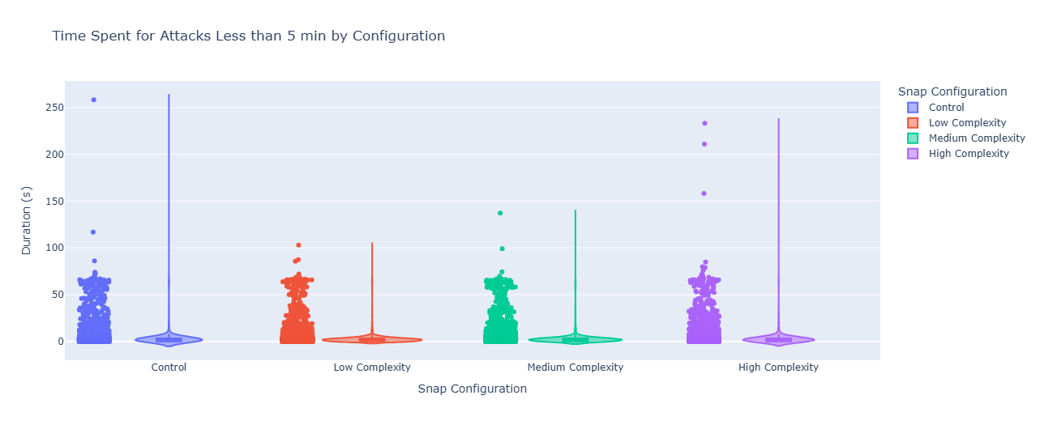
Duration of Attacks for All Attackers
Background
Research
Hypothesis
Architecture
Data Collect
Data Analysis
Conclusion
There is no statistical difference between the means of the four configurations for attacker duration in the total dataset.
 | p-value | F-statistic | Reject
ANOVA | 0.797 | 0.339845 | FALSE
KRUSKAL | 0.239 | 4.32 | FALSE
Notes:
Describe the monitoring system the team has in place and how it ensures the honeypots are operating as expected
Attacker duration always less than 5 minutes - 0.01 of attacks were above 5 minutes

Slide 12
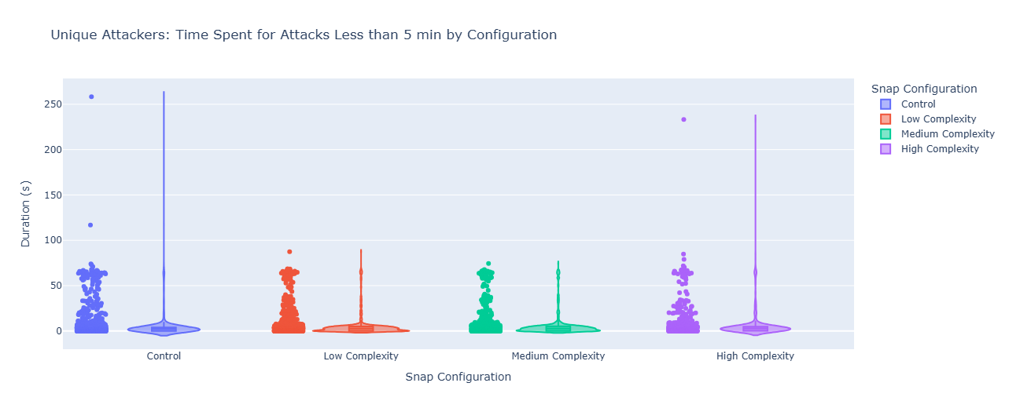
Duration of Attacks for Unique Attackers
Background
Research
Hypothesis
Architecture
Data Collect
Data Analysis
Conclusion
There is a statistical difference between the means of the four configurations for attacker duration in the total dataset.
 | Tukey | Dunn | Reject
Control/Low | 0.0299 | > 0.00001 | TRUE
Control/Medium | 0.0004 | > 0.00001 | TRUE
Control/High | 0.0003 | > 0.00001 | TRUE
Notes:
Describe the monitoring system the team has in place and how it ensures the honeypots are operating as expected

Slide 13
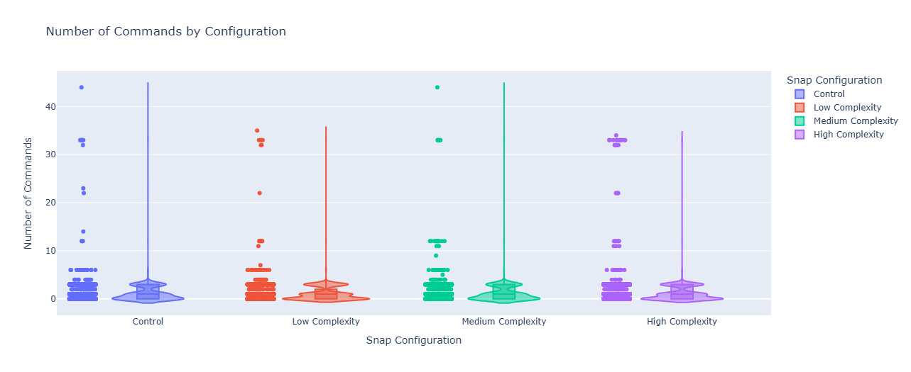
Number of Commands for All Attackers
Background
Research
Hypothesis
Architecture
Data Collect
Data Analysis
Conclusion
There is no statistical difference between the means of the four configurations for attacker duration in the total dataset.
 | p-value | F-statistic | Reject
ANOVA | 0.2049 | 1.528 | FALSE
KRUSKAL | 0.911 | 0.53 | FALSE
Notes:
Describe the monitoring system the team has in place and how it ensures the honeypots are operating as expected

Slide 14
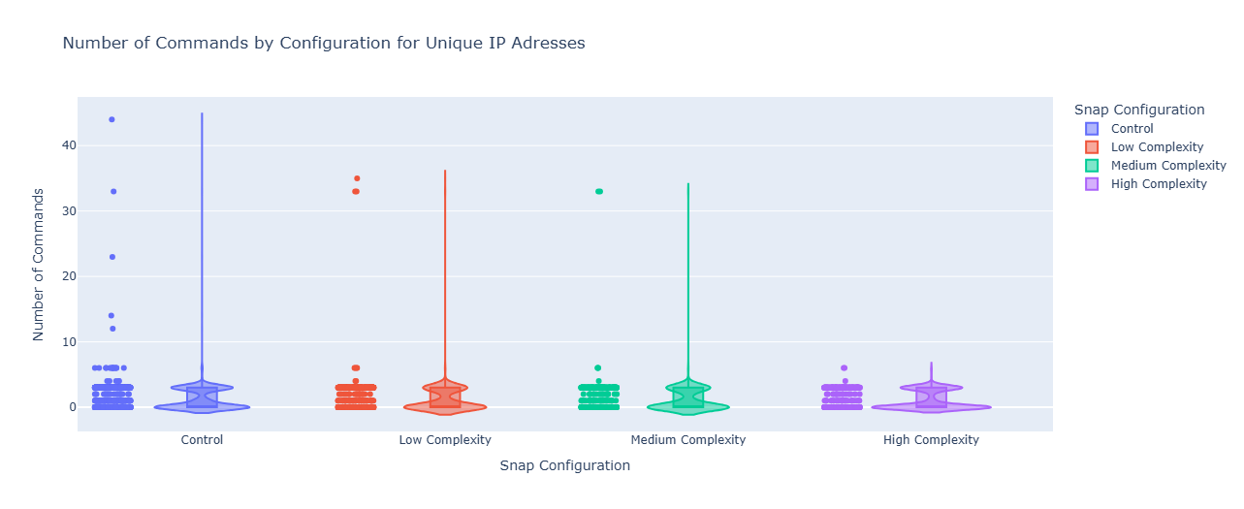
Number of Commands for Unique Attackers
Background
Research
Hypothesis
Architecture
Data Collect
Data Analysis
Conclusion
Control/High have statistically significant difference in the means. More tests are needed to give accurate conclusion for Control/Low and Control Medium.
 | Tukey | Dunn | Reject
Control/ Low | 0.5118 | 0.02544 | MIXED
Control/Medium | 0.5221 | 0.063716 | MIXED
Control/High | 0.0498 | 0.009283 | TRUE
Notes:
Describe the monitoring system the team has in place and how it ensures the honeypots are operating as expected

Slide 15
Key Takeaways
Background
Research
Hypothesis
Architecture
Data Collect
Data Analysis
Conclusion
Total successful connections: 31370
Total successful unique connections: 5897
Most attackers spent less than 5 minutes within the Honeypot
Most common commands include uname, and chattr/lockr
Statistical significance regarding attacker duration for Low, Medium, High complexity configs when compared to Control
Statistical significance regarding number of commands run for High complexity config when compared to Control
Expand the question to include password attempts into the honeypot itself
Notes:
Explain the outlined schedule for how the team will complete the project
Include visualization of your project management plan

Slide 16
Thank you!
Questions?

Slide 17
References
Cazier, J. A., & Medlin, B. D. (2006). Password Security: An Empirical Investigation Into E-Commerce Passwords and Their Crack Times. Information Systems Security, 15(6), 45–55. https://doi.org/10.1080/10658980601051318
Grassi, P. A., Garcia, M. E., & Fenton, J. L. (2017, June). Digital Identity Guidelines: Revision 3. https://doi.org/10.6028/nist.sp.800-63-3
Sahin, C. S., Lychev, R., & Wagner, N. (2015). General Framework for Evaluating Password Complexity and Strength. arXiv (Cornell University). https://doi.org/10.48550/arxiv.1512.05814
Yu, F., & Huang, Y. (2015). An Overview of Study of Password Cracking. IEEE. https://doi.org/10.1109/csma.2015.12

